Slide 1
Learning Algorithms
GAM 376

Slide 2
Learning
Hot topic in AI
Idea is to have the AI to learn and adapt to our games, the more they play it.
This will lead to a more believable AI.
However Not Often Used
Lots of computation
Prone to pitfalls
Very careful planning

Slide 3
Basics: Online
Two types of Learning: Offline & Online
Online
Allows AI characters to adapt dynamically while game is running
As player plays more, the player’s playstyle can be better anticipated by the computer
Can be used to make enemies a ongoing challenge or make the game build around what the player enjoys

Slide 4
Basics: Online
Cons
Predictability and testing
If the game is constantly changing, then replicating bugs and problems are very difficult
Like AI somehow deciding that running through a wall is the best option to catch the player
Worst case: have to replicate the whole sequence again to solve.

Slide 5
Basics: Offline
Offline
Majority of game AI is done offline
Ranges from processing between levels to processing in the development studio
Process data to calculate strategies or parameters for algorithms
Allows for more powerful and unpredictable learning algorithms to be tested.
Allows for more dynamic tactics in multiplayer games
Accurate Pathfinding and movement data
Bootstrap interaction with physics engine.

Slide 6
Basics: Offline
Applying learning between levels still counts as offline work.
Can still have issues
Time it takes to apply learning in between transitions
Bugs/Problems can only be found by playing the game lots of times.

Slide 7
Intra-Behavior Learning
Simplest learning algorithms only change a small aspect of the AI Behavior
Called: Intra-Behavior Learning
Goal:
Applying small tweaks to the game
Easy to control
East to test

Slide 8
Intra-Behavior Learning
Examples
Targeting projectiles with realistic bullet physics
Planning best patrol routes
Learning cover points of a room
Character evasion

Slide 9
Learning AI
The Dream
AI character can learn from scratch when introduced to a new game and provide a deep challenge to the player
Frontier Development
Decision making with learning systems
Making decisions between fixed sets of (parameterized) behaviors

Slide 10
Common Pitfalls
Not widely used (on a large scale)
Introduce slowly with caution
Hard to reproduce bugs and manage quality control
Example
Imagine enemies learning a complex environment over several hours of gameplay
Then enemy some gets caught in a cave and never leaves
Debugging would mean to keep replaying up to that point and tracking its certain behaviors so it can be avoided
Often impossible to achieve.

Slide 11
Common Pitfalls
Over-learning
If AI is exposed to a number of experiences and learns from them, it may learn only to respond to those situations
Rather we want the AI to generalize from limited number of experiences and can cope with a wide range of new situations

Slide 12
Parameter Modification
Simplest learning Algo is to calculate the value of one or more parameters.
Finding magic numbers for
Steering behaviors
Pathfinding
Behavior trees
Decision making

Slide 13
Parameter Landscape
Common solution for parameter learning
“Fitness Landscape” or “Energy Landscape”
Imagine the value of parameter as a specific location
Somewhere along a line
For each location there is a energy value
This value represents how good the value is (in game).

Slide 14
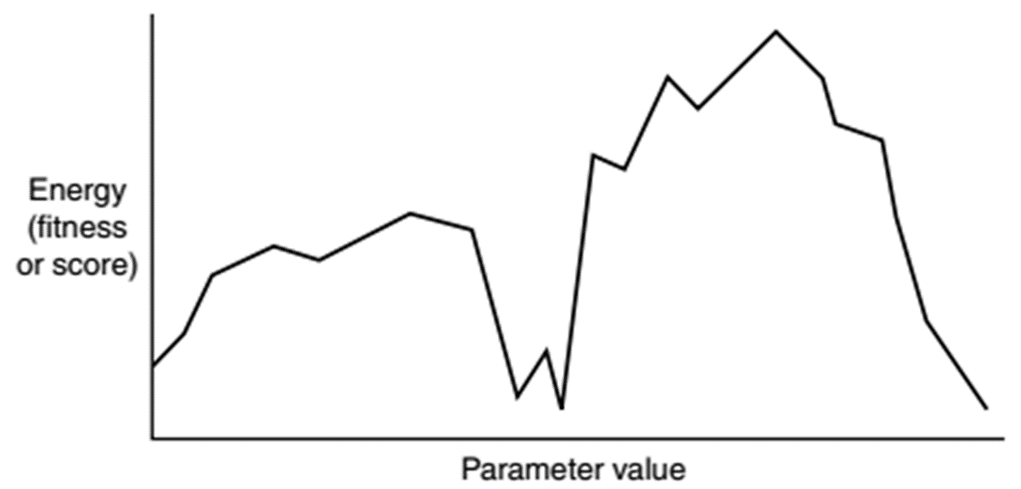
Parameter Landscape
Goal is to record results of each parameter value
Then find the best values of the parameter

Slide 15
Parameter Landscape
Your job is to quantify what is a good score
i.e. Zombie game, Energy == Survival Time

Slide 16
Energy & Fitness
Could be calculated through a function or formula
Most cases there is no magic mathematical formula
Process
Monitor performance of a parameter
Calculate a Fitness based on that parameter when task is completed.

Slide 17
Energy & Fitness
Depending on what your monitoring you can use different techniques to speed up the process.
Example
Speed up the game
Omit rendering.
Use heuristics to generate a value based on assessment criteria.
Further performance might change based on what the player is doing.
So it is completely fine for the fitness to change overtime.
Rather then having one fixed value

Slide 18
Hill Climbing
What values to test?
Can be completely random or educated guess
i.e. Zombie Game, Keeping health priority high is probably a safe bet
You could program make the choices for you.
Simple Algorithm:
Start with a random value
Then run program again with two new values
Slightly more positive and negative value
Then analyze the results
If one returns a better score then the other then test new values in that direction
Slightly more complicated with 2 or more parameters

Slide 19
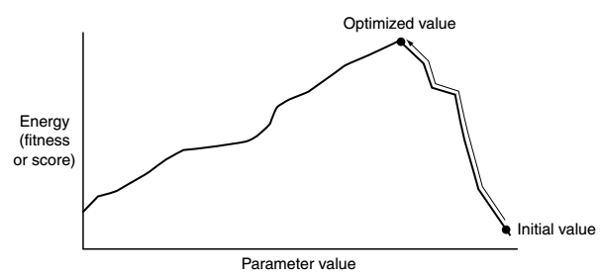
Hill Climbing

Slide 20
Hill Climbing
Problems
You could get multiple peaks with certain parameters
In that case you would get stuck.
These sub-peaks are called local maximum
More local maximums the more difficult to get a high quality fitness value.
Worst case all values are effectively random.

Slide 21
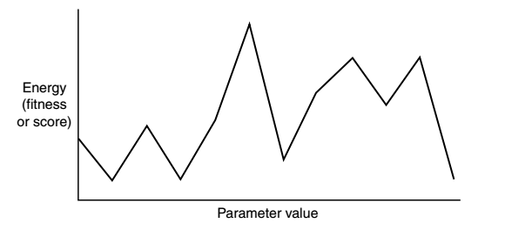
Hill Climbing Problems

Slide 22
Possible Solutions for Sub-Peaks
Momentum
If each search is consistently improving in one direction, then continue for a while and see where it leads.
Implementation
Momentum variable
Increasing
Each step it moves increase it proportionally with your previous movement and add it to the parameter value.
Decreasing
Same thing but decease the momentum variable.

Slide 23
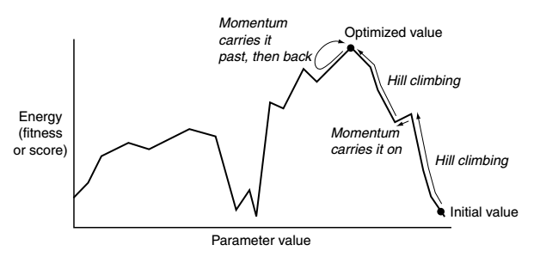

Slide 24
Finding Optimal Goal
Goal is to find best possible value
Example
RTS, best use of resources on either construction or research
We could run 100 trials and finds what appears to be the best but in reality it isn’t
But the AI is about appearance so finding the best might not only be wasteful but unnecessary

Slide 25
Action Prediction
Educated guessing
Often very useful
Humans are notoriously bad at behaving randomly
We cannot accurately randomize our actions
Magicians (cold reading) and Poker players can take advantage of this.
AI using simple prediction methods based on past data can easily predict human behavior
Notes:
http://www.loper-os.org/bad-at-entropy/manmach.html

Slide 26
Left or Right
Take simple game “Left or Right”
One player holds a coin in either their left or right hand.
Other player guess which hand the coin is in.
Even though physical giveaway “tells” can indicate a persons choice.
However a computer can win reasonably often against a player by analyzing past games.

Slide 27
Raw Probability
Easiest method is just to keep a tally of previous choices
Example
If player chose left 72 times and right 28 times
then AI will hide the coin in the right since player more likely choses left.
Easily countered if the player catches on to this method, using the algorithm against them

Slide 28
String Matching
Store player choices in a string
Example
“LRRLRLLLRRLRLRR”
AI based its choice on the last few choices the player has made
Example
Last 2 moves are “RR”
Analyzing string
2 right choices are always followed by a left
AI will predict the player will go for left hand
AI will hide coin in right.

Slide 29
String Matching
Rarely used by just matching against a string.
More often used as a set of probabilities
Previous example
We kept track of previous 2 choices
Call this window size of 2.
Using probability against a window size is called N-Gram predictor
Where N is one greater then window size
Window size 2 = 3-Gram

Slide 30
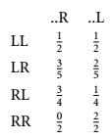
N-Grams
Left or Right Game
3-Gram
Window size = 2
4 different sequences
8 probabilities
AI will make its choice based on this table
Updates table after a round has been completed

Slide 31
Window Size
Increasing window size does increase performance
However it does peak
Increasing beyond a certain point will actually making the prediction even worse.
Any guess why?
Humans have horrible short term memory.

Slide 32
Window Size
Reasoning
Future actions are predicted by preceding actions
Rarely it’s a long process
Logical to think that analyzing several short sequence can help us predict a long sequence
However there is a degree of randomness in our actions
Longer the sequence, more randomness is introduced
Which makes poor predictions
We become random when we forget our previous actions.

Slide 33
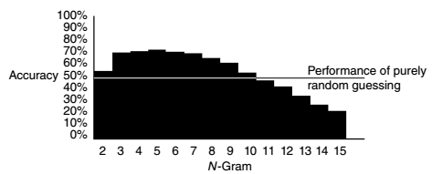
Window Size
Here is graph of Left Right Game
Shows accuracy vs size of window

Slide 34
Hierarchal N-Grams
When an N-Gram algorithm used for online learning
Balance between maximum predictive power and performance of the algorithm during initial stages of learning.
Larger Window
May improve potential performance
However will take longer to get to a reasonable performance level

Slide 35
Hierarchal N-Grams
Hierarchical N-Gram
Takes several N-Gram algos and works them in parallel
Example
3-Gram Hierarchical receives “LRR”
Passes to 3-Gram “LRR”
Passes to 2-Gram “RR”
Passes to 1-Gram “R”
Then when prediction is requested it looks at the 3-Gram first
If 3-Gram have sufficient examples then it uses the 3-Gram to make a prediction
If not it moves down a window.

Slide 36
Decision Learning
Goal is to have AI to learn to make better decisions
Focus on experience based learning
Learning is dealing with probability and often on a large set of data
It can be difficult to put hard constraints on learning behaviors

Slide 37
Decision Learning
Simplify the model
Character has set behaviors to chose from
Steering, Animations, Tactics, etc
Observable values that we can get from the game to use
Distance from enemy, ammo, size of army, etc.
Goal
Learn to which decisions fit better based on the observations to improve performance

Slide 38
Weak or Strong Supervision
Need feedback for learning algorithm
Feedback is called supervision
2 types: Weak or Strong
Strong
Set of correct answers
Learns to chose correct behavior given observable inputs
Keeps track of observations and decisions humans make.
Often by watching humans play the game
Background Process

Slide 39
Weak or Strong Supervision
Need feedback for learning algorithm
Feedback is called supervision
2 types: Weak or Strong
Weak
Does not require correct answers
Feedback is given based on good the action choices are
Feedback is provided usually by an algorithm that monitors AI Performance
AI plays the game multiple times recording its choices and how good action was

Slide 40

Weak or Strong Supervision
Need feedback for learning algorithm
Feedback is called supervision
2 types: Weak or Strong
Weak
Example
If AI chooses a path with a snake pit then dies
Feeback ==

Slide 41
Techniques for Decision Learning
1st Techinque: Niave Bayes Classifiers
Suppose Racing Game
Want AI to learn Player’s style of going around corners
Many factors going into cornering style
Many factors we can analyze
Lets look at a small subset
Brake, Distance, Speed
Keep track player’s previous input and create a data set.

Slide 42
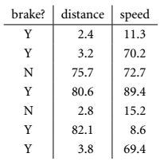
Naïve Bayes Classifiers
Small subset of data
First step is simplfy the data
Label distances as near and far
Below 20 is near
Label speeds as slow and fast
Below 10 is slow

Slide 43
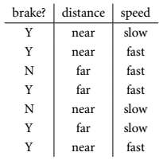
Naïve Bayes Classifiers
Small subset of data
First step is simplfy the data
Label distances as near and far
Below 20 is near
Label speeds as slow and fast
Below 10 is slow
Makes values easier to process

Slide 44

Naïve Bayes Classifiers
Now develop an conditional probability formula
Formula
Then applies Bayes rule

Slide 45
Naïve Bayes Classifiers
P(A|B)
Is the probability of A given B is true
P(A) & P(B)
Is probabilities of observing A or B without regard of each other
Alternate Format

Slide 46
Naïve Bayes Classifiers
Restated version for racing game
Now apply the naïve assumption
Now applying the Bayes rule with the naive assumption gives final formula

Slide 47
Example
Assume AI is entering a corner and deciding whether or not to brake
Distance = 79.2; Speed = 12.1
Probability of braking
Two possibilities: Brake or Don’t Brake
Lets analyze Brake

Slide 48



Example
Discretizing new values
Now use formula
From table of values we have 5 cases braking
2 far away
2 slow
Adding all together
Value ends up canceling itself out

Slide 49
Decision Tree Learning
Decision Trees
Series of decision that generate an action based on set of observations.
Based on clear detail of their world
You can apply Learning behaviors to DT
Constructing trees dynamically from sets of observations and actions.
Provided through strong supervision

Slide 50
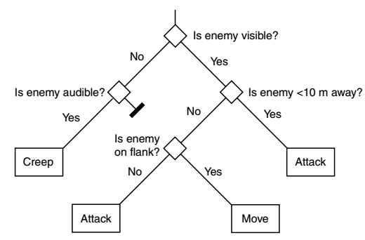
Decision Tree Learning

Slide 51
ID3
Inductive Decision Tree algorithm 3
Uses Observations
Often call “attributes”

Slide 52
ID3 Algorithm
Algorithm
Single leaf node and assigns examples to leaf node
Splits current node so that divides the examples into two groups
Decision is chosen based on an attribute that will most likely produce us the most efficient tree.
When division is done it will create 2 new nodes and applies a subset of examples to each of them.
Then repeats

Slide 53
ID3 Algorithm
Recursive algorithm.
Starts off with single node then splits them with decisions until the whole tree has been created.
Splitting
The split looks at each attribute in turn
Each possible decision
Calculates the information gain for each possible division.
The division with the highest information gain is chosen as the decision node.

Slide 54
Entropy
Entropy
Measure of the information in a set of examples
Degree to which actions in example set agree with each other
If all examples have same action entropy is 0
If all actions are distributed evenly then entropy is 1.
Information gain is the reduction of overall entropy

Slide 55
Entropy & Info Gain
Think of as degree of membership (DOM)
If we have a set of examples with all different actions then the set doesn’t tell us much on what to do.
Ideally we want to reach a situation where in a set tells us exactly which action to take.

Slide 56
Examples
Build the tree top down
A – the best decision attribute for next node
Assign A as the decision attribute for node
For each value of A, create a new descendant of node
Sort training examples to leaf nodes
If training examples is perfectly classified, stop, else iterate over new leave nodes.

Slide 57
Do I wear a coat?
Outlook | Temp | Routine | WearCoat
Sunny | Cold | InDoors | NO
Sunny | Warm | OutDoors | NO
Cloudy | Warm | InDoors | NO
Sunny | Warm | InDoors | NO
Cloudy | Cold | InDoors | YES
Cloudy | Outdoors | OutDoors | YES
Sunny | Cold | OutDoors | Yes

Slide 58
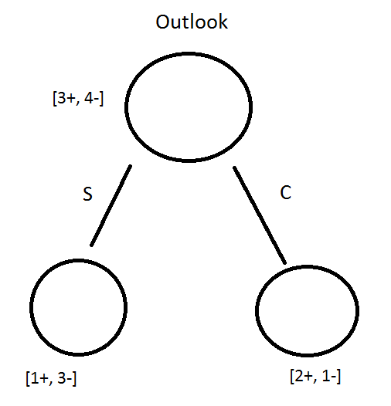
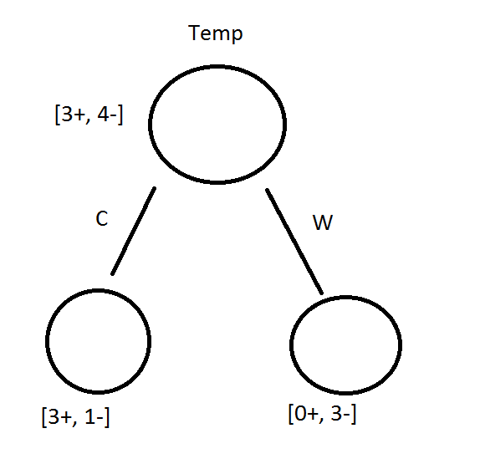
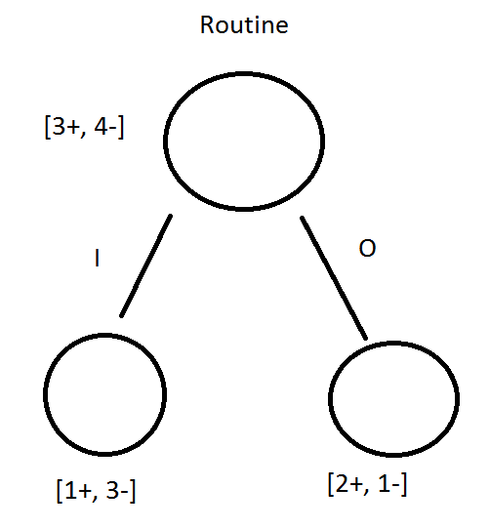
Outlook

Slide 59
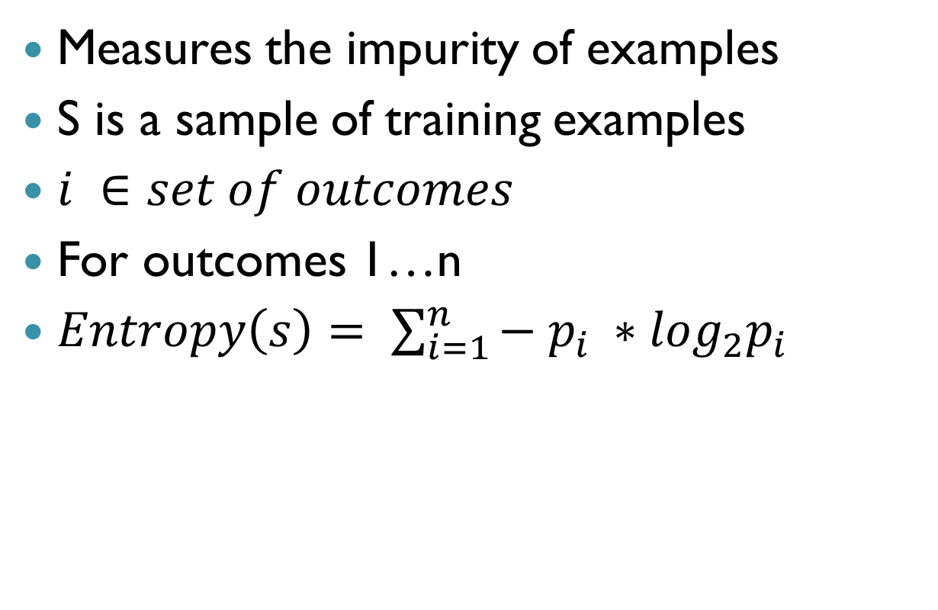
Entropy
Measures the impurity of examples
S is a sample of training examples
$i ∈set of outcomes$
For outcomes 1…n
$Entropy\left(s\right)= \sum_{i=1}^{n}{− p_{i} ∗\log_{2}p_{i}}$

Slide 60
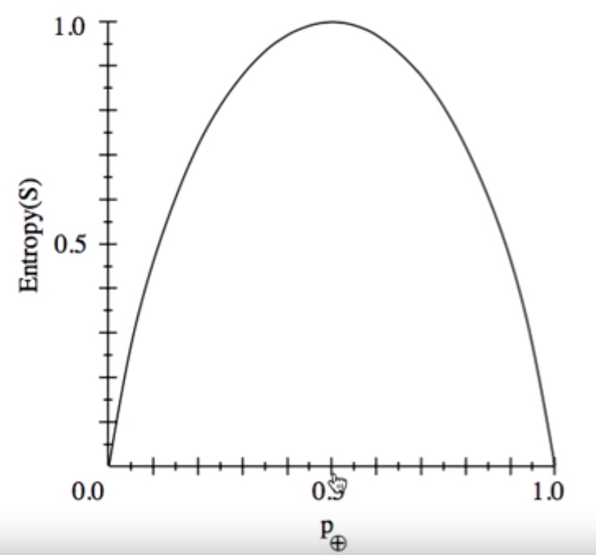
Entropy

Slide 61

Gain
Gain(S, A) = expected reduction in entropy due to sorting of A
$Gain\left(S, A\right)=Entropy\left(S\right)− \sum_{v∈Values(a)}{\frac{|S_{a}|}{|S|} Entropy(S_{a}) }$

Slide 62

Example
$Values\left(Outlook\right)=\left\{Sunny, Cloudy\right\}$
$S=[ 3+, 4−]$
$S_{Sunny}=\left[1+, 3−\right]$
$S_{Cloudy}=\left[2+, 1−\right]$

Slide 63
Another Example
2 Actions: Attack & Defend
3 Attributes: health, cover, and ammo
Each attribute (T/F)
Healthy or Hurt
Cover or Exposed
Ammo or Empty

Slide 64
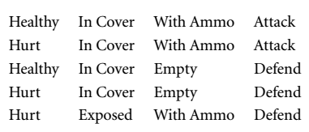
Set examples

Slide 65
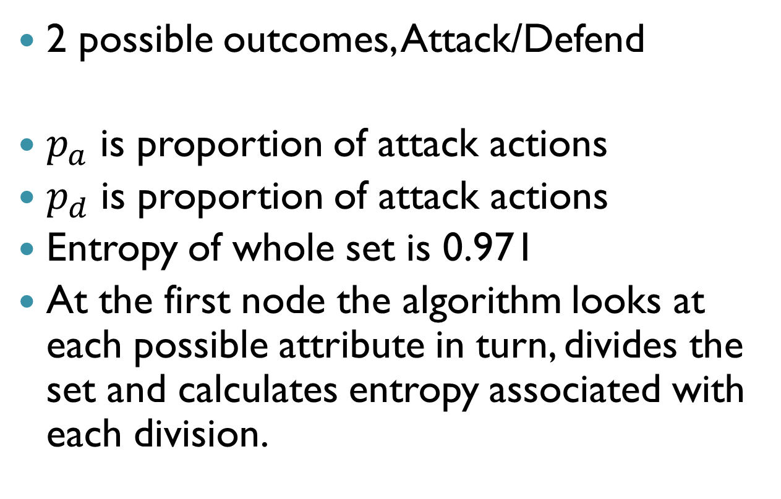
Outcomes
2 possible outcomes, Attack/Defend
$p_{a}$ is proportion of attack actions
$p_{d}$ is proportion of attack actions
Entropy of whole set is 0.971
At the first node the algorithm looks at each possible attribute in turn, divides the set and calculates entropy associated with each division.

Slide 66
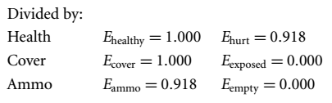
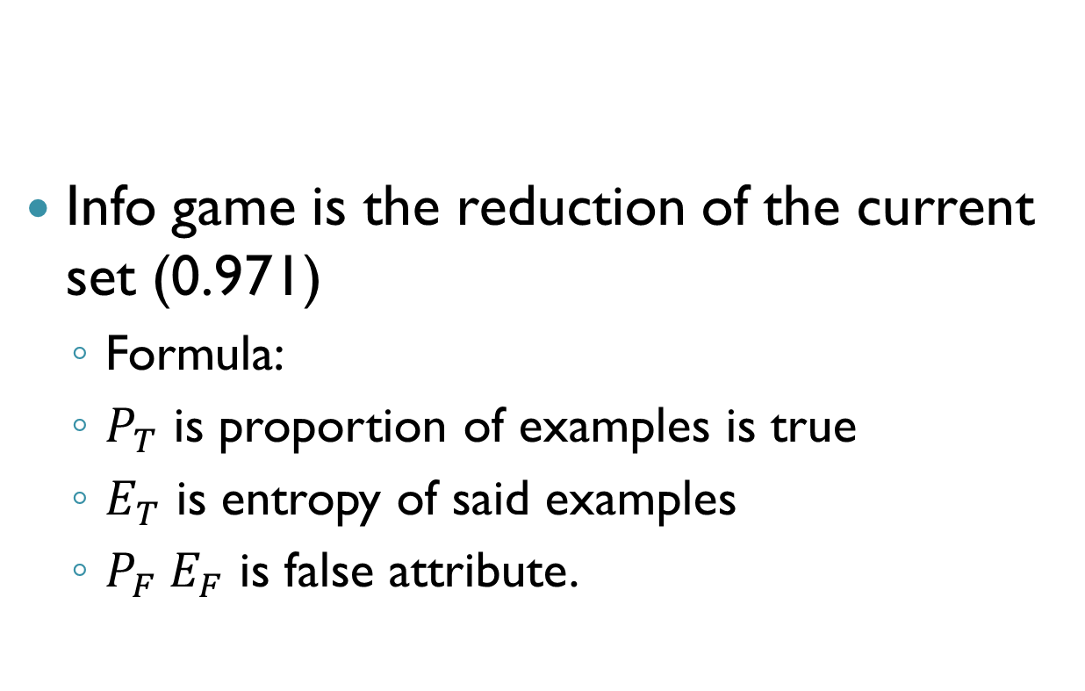
Example
Info game is the reduction of the current set (0.971)
Formula:
$P_{T}$ is proportion of examples is true
$E_{T}$ is entropy of said examples
$P_{F} E_{F}$ is false attribute.

Slide 67
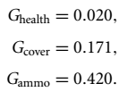
Example
Results give us the following
So of the 3, ammo is by far the best indicator of what action we should take
Makes sense, how can you attack without ammo?

Slide 68
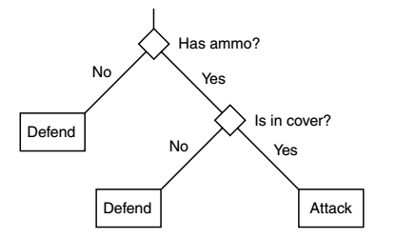
Resulting Tree

Slide 69
Reinforcement Learning
Reinforcement learning is range of techniques for learning based on experiences
Technique will discuss is
Q-Learning Algorithm

Slide 70
Q-Learning
Q-Learning relies on having problem represented in a particular way
Representation of the World
Treats world as state machine
Algorithm at any point is in some state
State encodes all relevant details about character’s environment and internal data
Example
If health is significant to learning process
If character finds itself in 2 identical situations with 2 different health levels
It will consider it them to be in different states

Slide 71
Q-Learning
Anything not found in the state cannot be learned
Q-Learning doesn’t need to understand the components of a state
i.e. health, enemy distance, etc.
Need to translate current state into a single state number (quantified value) for the learning algorithm
Fortunately, never have to transfer in the other direction.

Slide 72
Q-Learning
Model-free algorithm
Doesn’t try to build a model of the world
Easier to implement
For each state
It needs to understand the available actions it can take
After action is chosen, reinforcement function will give feedback
Common to keep range [-1,1]

Slide 73
Four Elements
Four elements to Q-Learning
Start State
Action Taken
Reinforcement Value
Resulting State
Experiencing Tuple
{s, a, r, s’}
Split into two sections
State and Action
Reinforcement Value and Resulting State
Q-Learning Rule

Slide 74
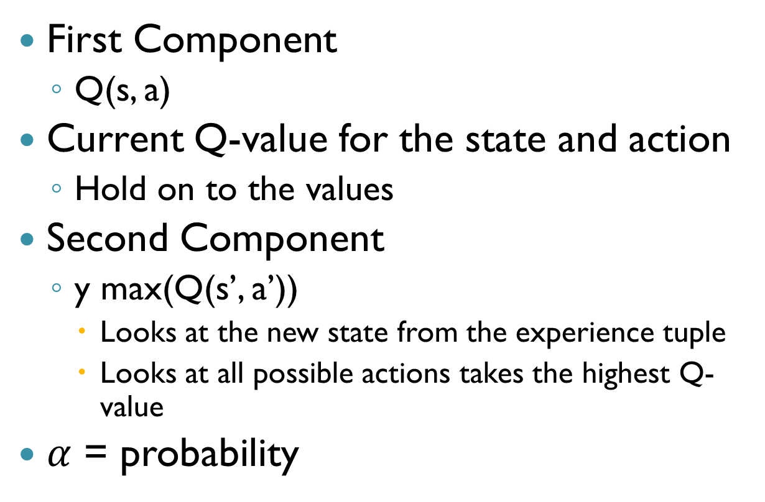
Components
First Component
Q(s, a)
Current Q-value for the state and action
Hold on to the values
Second Component
y max(Q(s’, a’))
Looks at the new state from the experience tuple
Looks at all possible actions takes the highest Q-value
$α$ = probability

Slide 75
Q- Learning Algo
For each state-action pair (s,a), initializes a table entry Q(s,a) to zero
Loop
Select an action a and execute it
Receive immediate reward r
Observe the new state s’
Update table entry for Q(s,a) as follows
s = s’

Slide 76
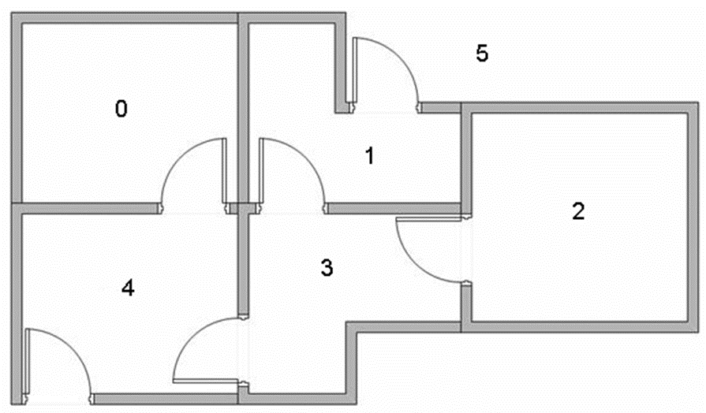
Example
Goal is that if agent is placed in any room he will go outside

Slide 77
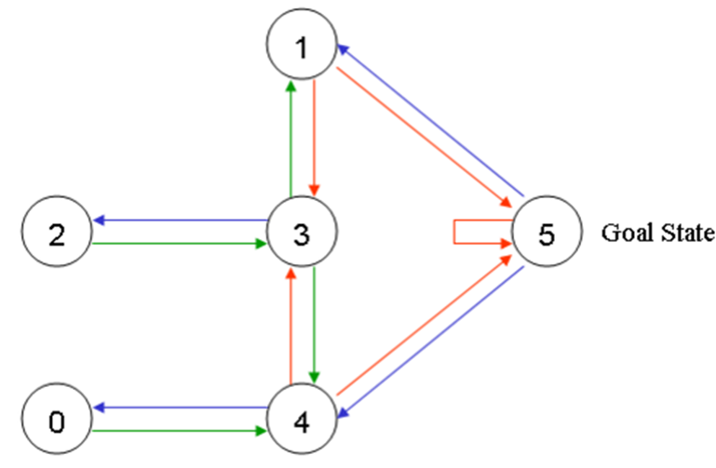
Example
Graph representation of the map

Slide 78
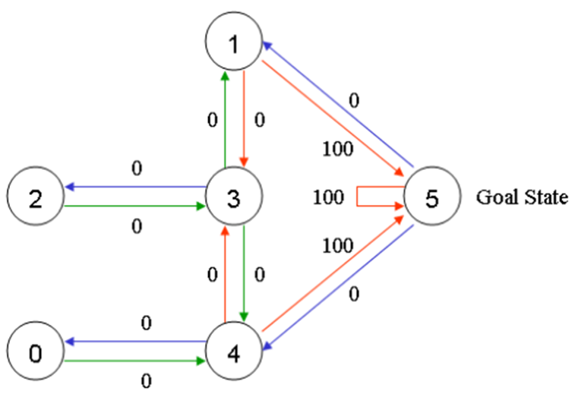
Example
Any room next to door that leads outside gets a score of 100
Rooms not connected to target get a 0

Slide 79
Example
Q-learning, goal is to reach the state with highest score
If it arrives at goal it will stay there forever

Slide 80
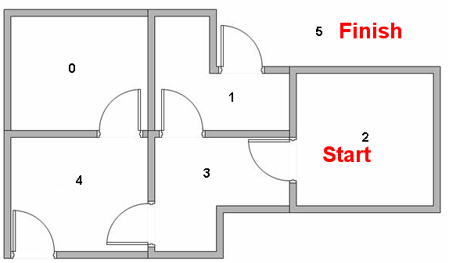
Example

Slide 81
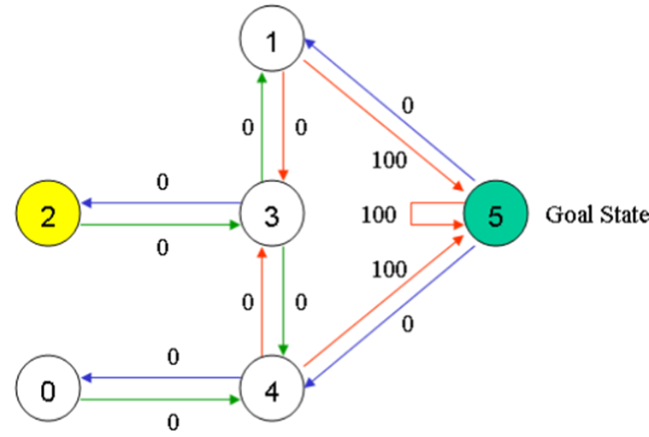
Example
Each room is a state
Moving room to room is an action
Example,
Assume agent starts at state 2, goal is 5

Slide 82
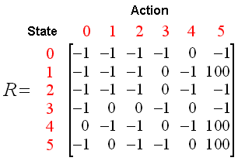
Example
After processing the graph
The reward values gives us the following table

Slide 83
Q-Learn Algo
Set gamma parameter and environment reward in Matrix R
Initialize Matrix Q to zero
For each Move:
Select a random initial state
While (goal reached == false)
Select one among possible actions for current state
Using possible action consider going to next state
Get Maximum Q value for next state on all possible actions
Compute:
Repeat for next state as current state

Slide 84
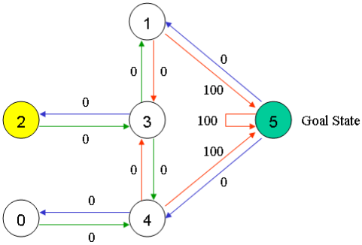
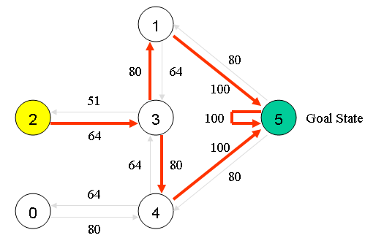
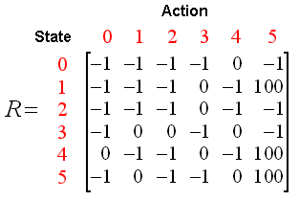
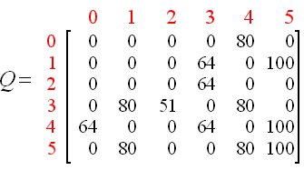
Example
Using algorithm gives following graph

Slide 85
Pseudo Code

Slide 86
Neural Networks
ANNs (neural networks)
“Biologically inspired” computing technique developed in 1970s.
Not widely used due to the complicated nature of programming and results.
Used for very specialized set of tasks.
We will go over basic techinques

Slide 87
Overview
Neural Networks
Consists of a large number of relatively simple nodes
Nodes are to simulate, neurons.
Just like brain cells
Each neuron communicates with a subset of other artificial neurons in the network

Slide 88
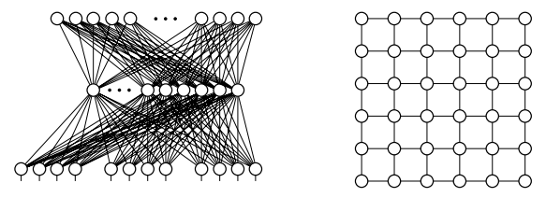
Example

Slide 89
Example
(Left Model) Shows a typical architecture for multi-layer perceptron (MLP) network.
Perceptron == artificial neuron
(Right Model) shows a Hopfield network
Network are arranged in grid

Slide 90
Neuron Algorithm
Neuron
Takes in a set of inputs, processes and returns a single output value (usually a float)
Has some state
Algorithm controls how neuron should generate a state based on inputs
In MLP, output state is passed to next layer
Each neuron is run in parallel
Or at least simulated (run in turn)

Slide 91
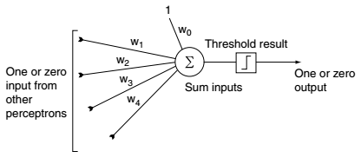
Neuron Algorithm
Each Neuron can have different algorithms
We treat each neuron as an individual entity running its algorithm

Slide 92
Neuron Algorithm
Process all inputs (can be weighted) returning a output value
Output value can in turn be a input value farther down the network

Slide 93
Learning
Without the learning aspect, it works as a very sophisticated hierarchal state machine
In MLP,
Normal Mode:
Input passed to input layer
Neuron processes input
Output passed to output layer

Slide 94
Learning
In ML,
Normal Mode:
Everything is processed forward
Learning Mode:
Everything is processed backwards
Start with output, and is back fed through the network
Called Backpropagation

Slide 95
Example
Take a Bot in a Team Deathmatch scenario
5 v 5 Deathmatch
19 Input Values
Distance to nearest 5 enemies
Distance to nearest 4 friends
Health of 4 Friends
Ammo of 4 Friends
Our health
Our Ammo

Slide 96
Example
5 output behaviors
Run away
Fight Valiantly
Heal Friend
Hunt Enemy
Find Power-up
Assume initial set of 20 to 100 scenarios
Each one a set of inputs with output we would like to see

Slide 97
Example
Network 3 Layers
Input Layer
Number of Nodes: 19
Output Layer
Number of possible outputs: 5
Intermediate (hidden) layer
Usually has minimum size of the input layer but possible more.

Slide 98
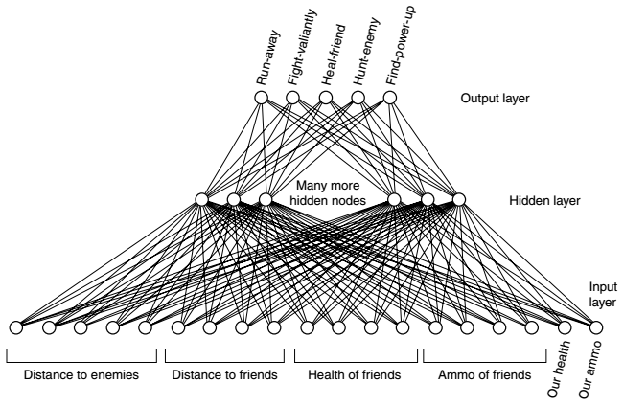
Example

Slide 99
Example
Scenarios are split into two groups
Training set (learning)
Testing set (check on how learning is going)
10 training and 10 testing for this example would be minimum
50 would be better

Slide 100
Setup and Framework
Start by initializing all weights to small random values
Then process each scenario (Two Steps)
Feedforward
Takes input and guesses an output
Backpropagation
Modifies the network based on the real output and the guess

Slide 101
Setup and Framework
After each iteration is complete
Network has learned
Test if the learning was successful
This is done by running feedforward process on the test set of examples.
If guessed output matches the output were looking for
Then good sign the network has learned properly.

Slide 102
Feedforward
Generate an output from input values
Set the states input layer neurons directly
For each neueron (in hidden layer)
We perform its Algorithm
Summing weighted inputs
Applying a threshold function
Generating its output
Can perform same process on output layer

Slide 103
Backpropagation
To learn
Compare the state of the output nodes with the current pattern
Desired output is zero for all output nodes, except one corresponding desired action
Work backward layer at a time form output layer, updating all weights

